Slide 1

Session : 3
SQL SESSION
Data Science & AI BOOTCAMP Session
“Our Limit is the Space”

Slide 2



Data Science & AI Board
Eng. Saher Muhamed
Head of Data Science & AI
SWE @Shipd || Ex. Data Analyst @ Digitell || Ex. Data Science Intern @ TaQa-Arabia || IBM & Google Certified Data Analyst || NTI Machine Learning Trainee

Slide 3

Data Science & AI Board
Eng. Ziad Mostafa
Vice Head of Data Science & Ai
Microsoft Certified Data Scientist || Ex. Data Scientist @ ZeNN || Ex. Data Analyst Intern @ ENAKL || Ex. Data Science Trainee @ SHAI For AI

Slide 4












Data Science & AI Core Team
Eng. Mohamed Ashraf
Data Scientist
||BI Trainee @ITI
Eng. Mohamed Shehab Core Team Data Science & AI
@GDG-On Campus ||
Data Analysis Trainee @Growth-Level
Eng. Mostafa Eliwa
Microsoft Certified
Machine Learning @DEPI
|| Second Place At DEPI
Grad-Projects Competition Overall Egypt
Eng. Ibrahim Said Mosa
AI systems member
Technical member at GHOSTECH(2023) event @IEEE-BUB ||
Core Team member
@GDG-On Campus
Eng. Azza Yehya
Kaggle Expert || Data Analyst Trainee @ PEA Learn Company || AI Diploma Graduate @ MEC Academy
Eng. Ibrahim Abdelfatah
Data Science & AI core team member @GDG-BUE || Electrical engineering student || Graduated Data Scientist from DEPI Microsoft SC EELU Data Science student
Eng. Mostafa Sobieh
data analyst|| BI Development internship from ITI || core team & instructor data science & AI @ GDG On Campus
Eng. Habiba Khaled
Microsoft certified data engineer@depiBI trainee@iticoding insrtucor@idevelopercore-team member@gdg on campus
Eng. Wafaa Ahmed
Core team member at GDG BenhaITI trainee
Eng. Mohamed Ashraf
Technical Data Science & AI @GDG-On Campus || power pi developer || Data Analyst
Eng. Nada Mohamed Data Analyst & Scientist Core team Data Science & AI @ GDG on Campus Trainee to CodeAlpha
Eng. Naira Zidan
Orange certified AI trainee || Old Core-team data analysis

Slide 5












Data Science & AI Core Team
Eng. Ganna Mahmoud
Data Scientist || Core Team Data Science & AI @GDG-On Campus|| BI Trainee @ITI
Eng. Abdelrahman Amr Data Analyst and Scientist || Core Team Data Science and AI @GDG-On Campus || Laptop Maintenance Engineer
Eng. Muhammed Al Reay
Data science & AI @GDG on-campus || IT&Sap Trainee @EIM Group
Eng. Shahd yehia
Core team member @ GDG_On Campus Datacamp certified data analyst
Eng. Reem Kasab
student @BFCAI || Data Science trainee @DEPI || AI member @IEEE ||Data science member @GDG on campus
Eng. Nour Adel
CORE TEAM | DATA SCIENCE AND AI @ GDG ON CAMPUS
Eng. malak Abd Elgwad Core team in Data science &AI@ gdg google developer _on campus.Data science trainee
Eng. Habiba Mohamed
Core team member of Data Science & Ai @GDG- On Campus || Business Intelligence Trainee@ITI ||Member of Ai @IEEE-BUB
Eng. Esraa Alaa
Core Team Data Science & AI @GDG ||.Mechanical Engineer(Sealing) member @SailFish RovTechnical member @ IEEE-BUB.
Eng. Niera ElShamy
Core team member Data Science & Ai @GDG-On Campus||Data Analysis&Excel Trainee @itida ||Technical member at"the Egyptian league for Robotics&ai" Competition @CODEAVOUR
Eng. Mohamed Khaled
Data Analyst
ITI trainee
Eng. Gehad Mohamed
Data Analyst & Scientist Core team Data Science & AI @ GDG on Campus

Slide 6


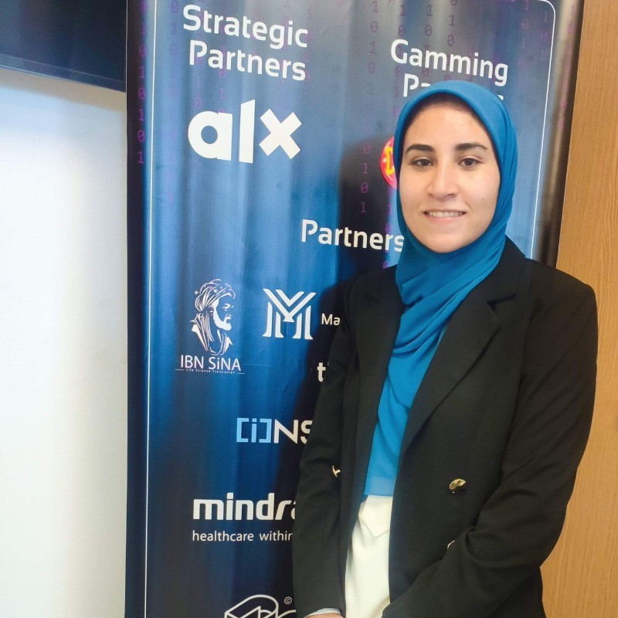

Data Science & AI Core Team
Eng. Marwan Emam
Core team of Data Science & AI @GDG-On Campus || Ex. Data Science Trainee @ITI
Eng. Jana Walid
Core team data science &AI @GDG On campus
Eng. karima mahmoud IBM Data Scientist trainee @DEPI
Eng. Yasmeen Walid Data Scientist || Data Science Core team @ GDG

Slide 7

Play With Models Not Emotions🤧

Slide 8
Session Content
1. Intro to Databases and SQL | What is databases? And what is SQL language?
2. Basic SQL Query | Select, From, and Where statements.
3. Column Data Types | Numeric, Data\Time, Char\String and Binary
4. Primary Key & Foreign Keys | The difference between primary and foreign keys
5. Key Components of SQL Scripting | Difference between DDL, DML, DCL and TCL
6. Intro to DDL SQl | CREATE, ALTER, DROP and TRUNCATE statements
7. Intro to DML SQL | INSERT, SELECT, UPDATE and DELETE statements
8. Grouping By & Order By | What is group by? When to use? How to use? What is order by? When to use? Difference between ascending and descending.
9. Aggregation Functions | Count, Round, Min, Max, Average, …
10. KPIs, & Metrics | What are KPIs? What are Metrics
11. Practice Time | Practise on a real Data

Slide 9
01:
Intro to Databases and SQL

Slide 10
What is Databases
What is SQL?
A database is a structured collection of electronic data, systematically organized for efficient storage, retrieval, and management. It serves as a centralized repository, ensuring data integrity and supporting various applications in handling information.
SQL (Structured Query Language) is a standardized programming language used to manage and manipulate relational databases. It provides a set of commands for tasks such as querying, updating, inserting, and deleting data within a database. SQL enables users to interact with databases in a uniform and efficient manner, facilitating seamless communication with the underlying data structure.

Slide 11
02: Basic SQL Query

Slide 12
Basic SQL Query
- SELECT : The Select statement is used to retrieve data from a database.
- FROM : specifies the source table from which data is to be retrieved in the SELECT statement.
- WHERE : WHERE is a condition clause in the SELECT statement that filters data based on specified criteria.
SELECT First_Name, Last_Name FROM employees WHERE department = 'IT';

Slide 13
03: Column Data Types

Slide 14
SQL Data Types
Numeric Data Types:
INT : It is the primary integer data type in SQL Server. It is used for between -2.147.483.648 and 2.147.483.647 values; takes up 4 bytes size.
BIGINT : It is intended for use when integer values might exceed the range that is supported by the int data type. It takes up 8 bytes
DECIMAL : In this data type, the number of digits of the number and scale to be stored can be defined. The size depends upon precision. The number of precision digits can be defined between 1 and 38.
Date and time
DATE : Its format is YYYY-MM-DD and takes up 3 bytes.
TIME : Its default format is HH:MM:SS and takes up between 3 to 5 bytes
DATETIME : It defines a combined data type date with a time of day with fractional seconds and it takes up 8 bytes. YYYY-MM-DD HH:MI:SS
Character strings
VARCHAR(n): Stores non-Unicode characters, typically used for English or other languages that do not require Unicode encoding. It takes up as much as the size data
NVARCHAR(n) : Stores Unicode characters, which means it can handle multiple languages, including Arabic, Chinese, and any other script requiring Unicode. It uses 2 bytes per character for storage.
Other Data types
BOOLEAN : Stores TRUE or FALSE values. It is fundamentally different from bit.
BINARY : It presents 1 and 0 with fixed length. The maximum length can be up to 8000 bytes.

Slide 15
04: Primary Key & Foreign Keys

Slide 16
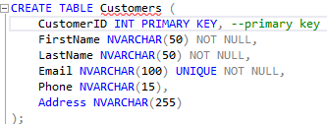
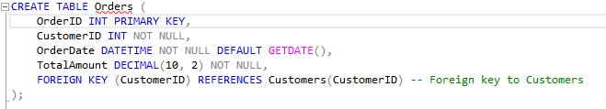
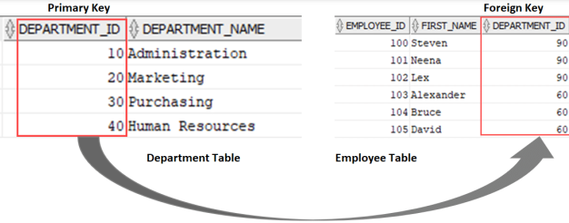
SQL Data Types
Primary Key:
Uniquely identifies each record in a table.
Must contain unique values and cannot be NULL.
A table can have only one primary key, which can consist of one or more columns (composite key).
Foreign Key:
A column (or set of columns) that establishes a relationship between two tables by referencing the primary key in another table.
May contain duplicate values and can be NULL.
Used to enforce referential integrity between tables.

Slide 17
05: Key Components of SQL Scripting

Slide 18
Key SQL Script Components
SQL Script Components | Description
DDL (Data Definition Language) | Used to define and manage database structures.
DML (Data Manipulation Language) | Used to manipulate data within the structures.
DCL (Data Control Language) | Used to control access to data
TCL (Transaction Control Language) | Used to manage transactions in the database.

Slide 19
06: Intro to DDL in SQl

Slide 20
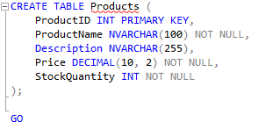
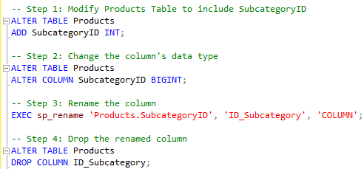
Data Definition Language in SQL
DDL commands are used to define and modify database structures.
CREATE: Create database objects like tables, indexes, and views.
ALTER: Modify existing database objects.
TRUNCATE: Remove all records from a table, but not the table itself
DROP: Delete database objects.

Slide 21
07: Intro to DML in SQl

Slide 22
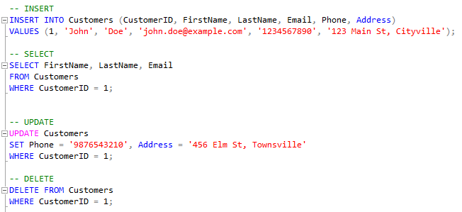
Data Manipulation Language in SQL
DML commands are used to manipulate data within tables.
INSERT: Add new records to a table.
SELECT: Query data from the database
UPDATE: Modify existing records
DELETE: Remove records from a table

Slide 23

Activity Time

Slide 24
08: Aggregation Functions

Slide 25
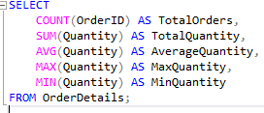
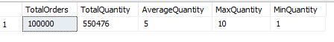
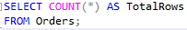
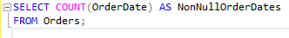
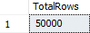
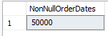
Aggregation Functions in SQL
COUNT : an aggregate function in SQL used to count the number of rows in a result set, satisfying specified conditions if provided.
ROUND : is a mathematical function in SQL used to round a numeric value to a specified number of decimal places.
MIN : an aggregate function in SQL used to retrieve the minimum value from a set of values in a specified column.
MAX : an aggregate function in SQL used to retrieve the maximum value from a set of values in a specified column.
AVERAGE : often computed using the AVG function in SQL, is an aggregate function that calculates the average value of a numeric column in a result set.
COUNT(*): Counts all rows, regardless of the values in any specific column. It counts the total number of rows in a result set.
COUNT(column_name): Counts the number of non-null values in the specified column. It excludes rows where the value in the specified column is null.

Slide 26
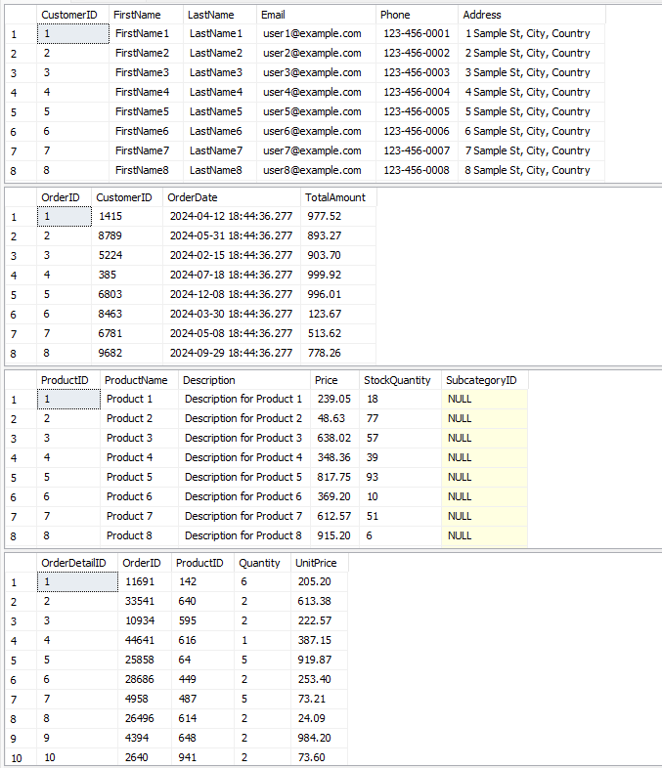
E-Commerce Database

Slide 27
09: Ordering By & Grouping By

Slide 28
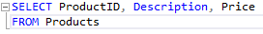
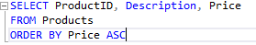
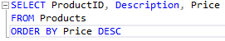
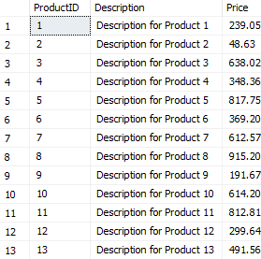
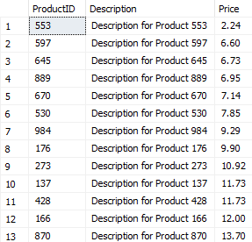
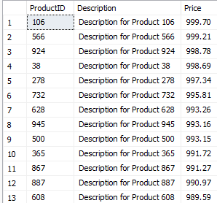
1. Order By
What is order by?
The ORDER BY clause is used in SQL queries to sort the result set of a SELECT statement based on one or more columns. It allows arranging the output in ascending (ASC) or descending (DESC) order
ASC
DESC

Slide 29
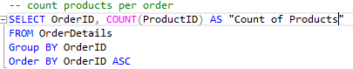
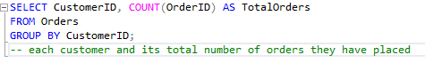
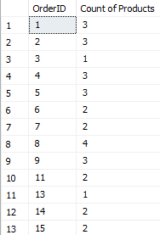
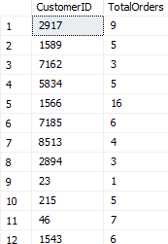
2. Group By
- Group By: used to group rows that have the same values in specified columns into summary rows, like aggregations. It is often used in conjunction with aggregate functions (e.g., COUNT, SUM, AVG) to perform calculations on each group of rows.

Slide 30
10: KPIs & Metrics

Slide 31
KPIs and Metrics
-KPIs (Key Performance Indicators) : Key metrics that measure the performance of an organization, department, or process. They are strategic, high-level indicators directly tied to business goals.
- Average order value (AOV): measures the average costs per order spent by a customer with an online merchant.
-Metrics : Quantifiable measurements that track and assess specific aspects of a business or operation. They provide detailed insights into performance but may not always be directly tied to high-level strategic objectives.
- Average Salary : A quantifiable measurement providing detailed insight into employee compensation.

Slide 32

LET’S GO TO WORK🤧

Slide 33
We are here for yourself then for our vision !
#1Global

Slide 34
Thanks!
You present GDG Family Not You !

Slide 35
Our Limit Is the Sky🚀 See you Soon !!

